Slide 1
EEE 363 induction motor
Class Schedule : MW 1:00 PM – 2:40 PM
Instructor : Dr. Shohana Rahman Deeba
Department of Electrical and Computer Engineering
Office: SAC-1010B
Email: shohana.deeba@northsouth.edu

Slide 2
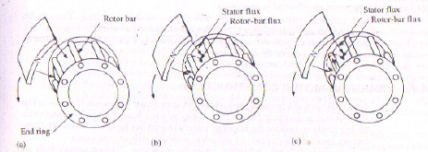
Basic Principle of 3-Phase Induction Motor
Invented by Nicholas Tesla in 1888
Converts electrical energy to mechanical energy
Containing both stationary and rotating parts in the construction
Stationary part- Stator
Rotating part – Rotor
Stator- 3 blocks of iron each 120 degree apart, carries wounded coils
Coils are supplied by 3-phase electric power
Rotor situated inside stator, rotates due to electromagnetic induction

Slide 3
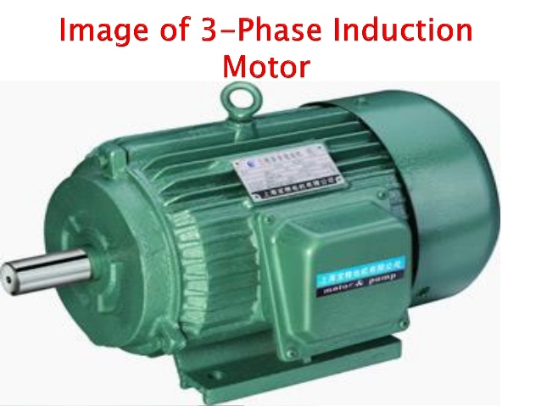
Working Principle of Induction Motor

Slide 4
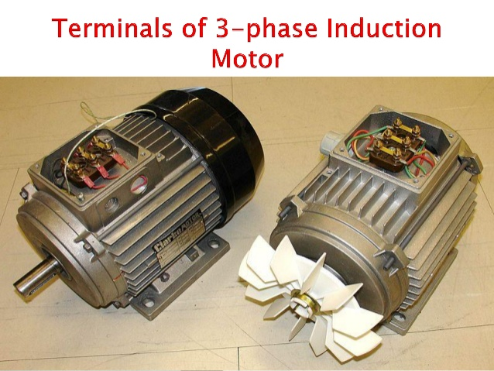
Working Principle of Induction Motor

Slide 5
Working Principle of Induction Motor
Three-phase induction motors are the most common and frequently encountered machines in industry
simple design, rugged, low-price, easy maintenance
wide range of power ratings: fractional horsepower to 10 MW
run essentially as constant speed from zero to full load
speed is power source frequency dependent
not easy to have variable speed control
requires a variable-frequency power-electronic drive for optimal speed control

Slide 6
Working Principle of Induction Motor
a revolving rotor
composed of punched laminations, stacked to create a series of rotor slots, providing space for the rotor winding
one of two types of rotor windings
conventional 3-phase windings made of insulated wire (wound-rotor) » similar to the winding on the stator
aluminum bus bars shorted together at the ends by two aluminum rings, forming a squirrel-cage shaped circuit (squirrel-cage)
Two basic design types depending on the rotor design
squirrel-cage
wound-rotor

Slide 7
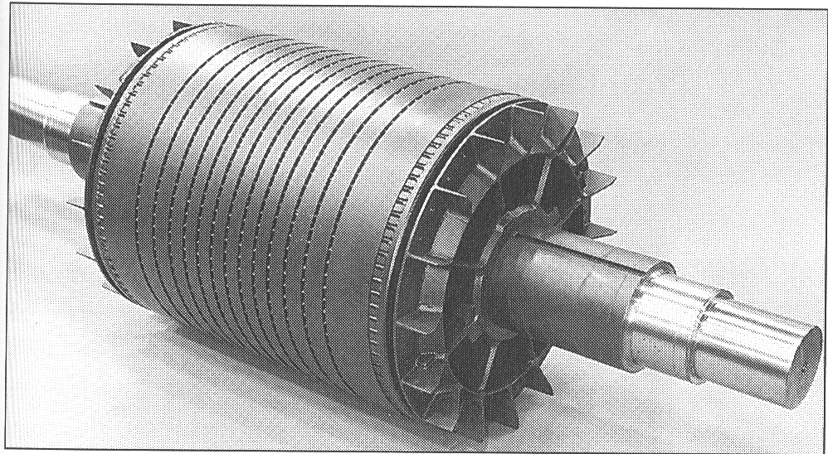
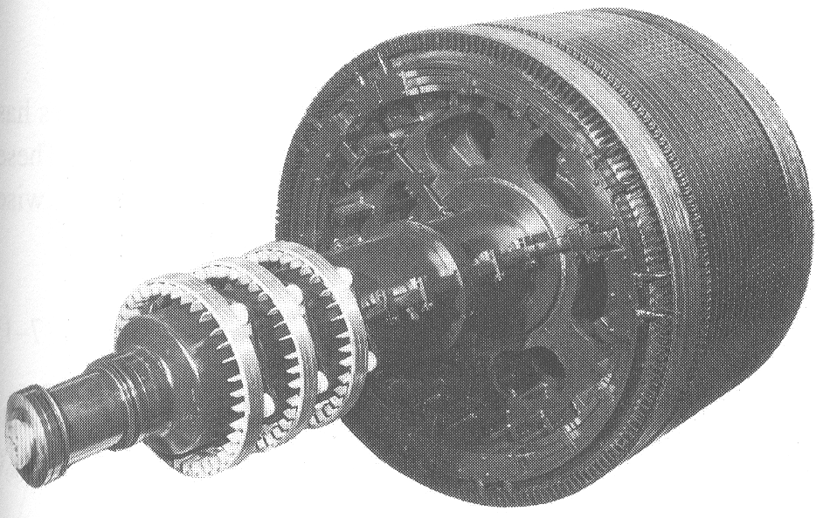
Construction
Squirrel cage rotor
Wound rotor
Notice the slip rings

Slide 8
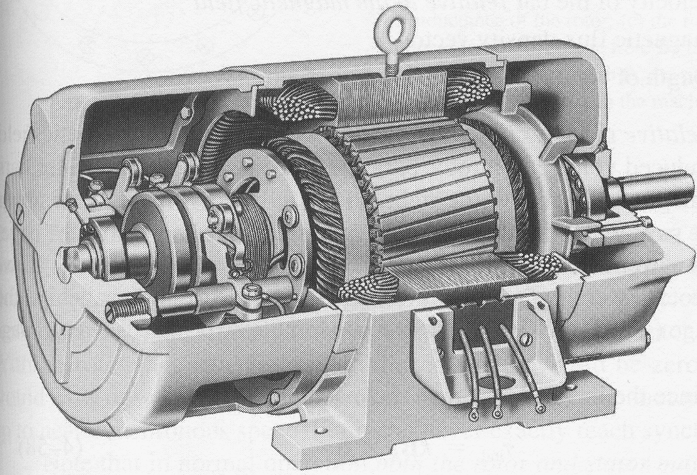
Construction
Slip rings
Cutaway in a typical wound-rotor IM. Notice the brushes and the slip rings
Brushes

Slide 9
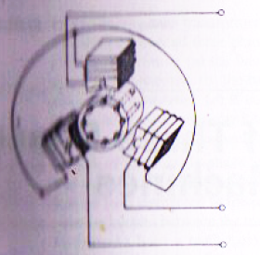
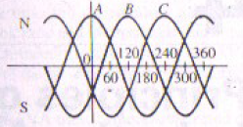
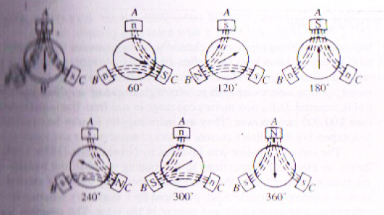
Principle of operation

Slide 10
Principle of operation
This rotating magnetic field cuts the rotor windings and produces an induced voltage in the rotor windings
Due to the fact that the rotor windings are short circuited, for both squirrel cage and wound-rotor, and induced current flows in the rotor windings
The rotor current produces another magnetic field
A torque is produced as a result of the interaction of those two magnetic fields
Where τ_{ind} is the induced torque and B_{R} and B_{S} are the magnetic flux densities of the rotor and the stator respectively

Slide 11
Induction motor speed
At what speed will the IM run?
Can the IM run at the synchronous speed, why?
If rotor runs at the synchronous speed, which is the same speed of the rotating magnetic field, then the rotor will appear stationary to the rotating magnetic field and the rotating magnetic field will not cut the rotor. So, no induced current will flow in the rotor and no rotor magnetic flux will be produced so no torque is generated and the rotor speed will fall below the synchronous speed
When the speed falls, the rotating magnetic field will cut the rotor windings and a torque is produced
https://www.youtube.com/watch?v=AQqyGNOP_3o

Slide 12
Induction motor speed
So, the IM will always run at a speed lower than the synchronous speed
The difference between the motor speed and the synchronous speed is called the Slip
Where n_{slip}= slip speed
n_{sync}= speed of the magnetic field
n_{m} = mechanical shaft speed of the motor

Slide 13
The Slip
Where s is the slip
Notice that : if the rotor runs at synchronous speed
s = 0
if the rotor is stationary
s = 1
Slip may be expressed as a percentage by multiplying the above eq. by 100, notice that the slip is a ratio and doesn’t have units

Slide 14
Example 7-1 (pp.387-388)
A 208-V, 10hp, four pole, 60 Hz, Y-connected induction motor has a full-load slip of 5 percent
What is the synchronous speed of this motor?
What is the rotor speed of this motor at rated load?
What is the rotor frequency of this motor at rated load?
What is the shaft torque of this motor at rated load?

Slide 15
Solution

Slide 16
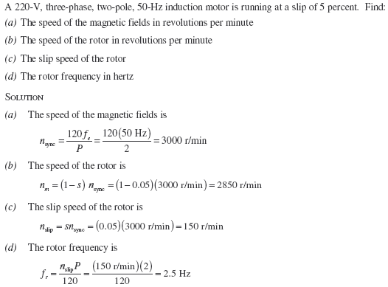
Problem

Slide 17



Slip and its effect on rotor frequency

Slide 18
Effect of slip on rotor voltage

Slide 19
A three phase, 230V, 60Hz,100hp, six pole induction motor operating at rated condition has an efficiency of 91% and draws a line current of 248A. The core loss, stator copper loss and rotor conductor loss are 1697W, 2803W and 1549W, respectively. Determine (a) power input (b) total losses (c) air-gap power (d) shaft speed (e) power factor (f) combined windage, friction, and stray load loss (g) shaft torque
Relevant problems 4.10,4.11,4.12,4.13-4.17.

